Slide 1
Inventory Management For Car Showroom

Slide 2
Required Features
User management With Static Roles
Login Page (Roles : Manager / Salesman )
Add Cars
Add Spare
New Supply / Add Stock
Inventory List
Stock Detail Page
Order Page
Order Detail Page

Slide 3
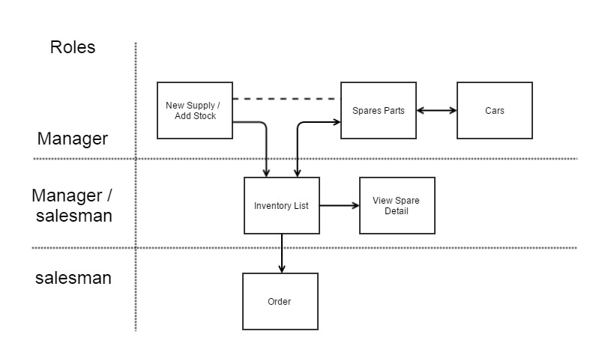
Block Diagram

Slide 4
Inventory List
Spare name | Model | Quantity | Support cars | View
Glass | AS2432 | 20 | BMW Z4 Roadster , BMW 650i Coupe
Heat Exchangers | AS456 | 100 | BMW 650i Coupe , BMW 650i Coupe
Air Bags | AS432 | 42 | BMW Z4 Roadster
view
view
view

Slide 5
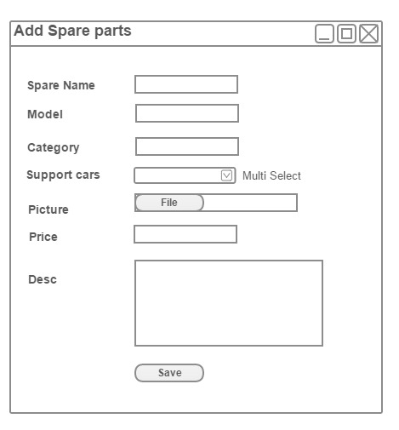
Add Spare

Slide 6
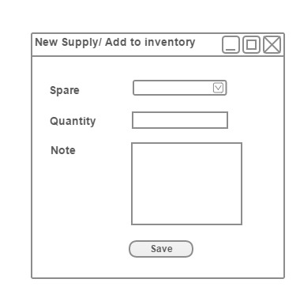
New Supply / Add Stock

Slide 7
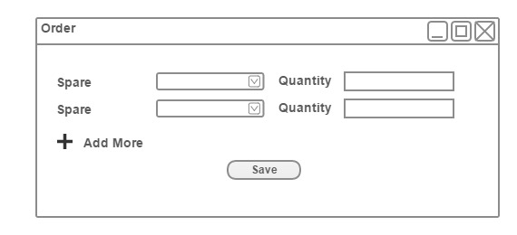
Order Page

Slide 8
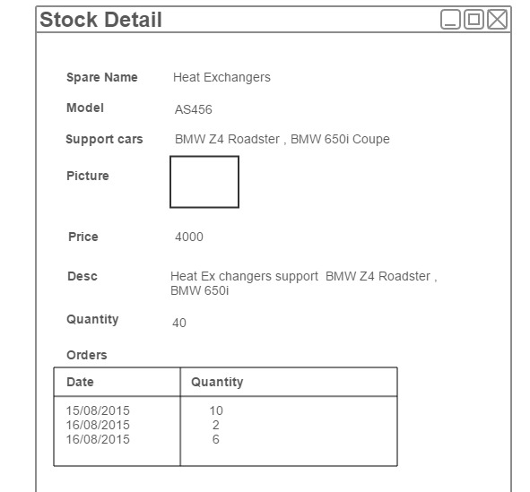
Spare Detail

